Slide 1
Big O Notation September 3, 2019

Slide 2
Introduction
There are multiple ways to solve a problem using a computer program
All these algorithms have their own pros and cons
The question is, which algorithm to use to solve a specific problem when there exist multiple solutions to the problem?
Algorithm analysis refers to the analysis of the complexity of different algorithms and finding the most efficient algorithm to solve the problem at hand
Big-O Notation is a statistical measure, used to describe the complexity of the algorithm.

Slide 3
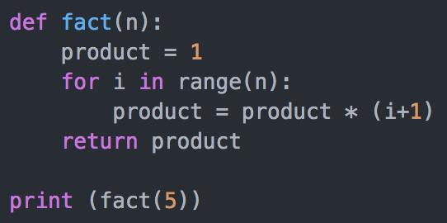
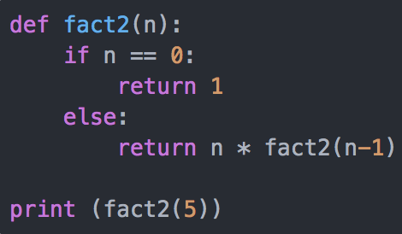
Introduction
Suppose a manager gives a task to two of his employees to design an algorithm in Python that calculates the factorial of a number entered by the user
The algorithm developed by the The algorithm developed by the 1st employee looks like this: 2nd employee looks like this:
The manager has to decide which algorithm to use. To do so, he has to find the complexity of the algorithm. One way to do so is by finding the time required to execute the algorithms.
Using a common library function, the execution times are:
The execution time shows that the first algorithm is faster compared to the second algorithm involving recursion. However, execution time is not a good metric to measure the complexity of an algorithm since it depends upon the hardware. A more objective complexity analysis metrics for the algorithms is needed. This is where Big O notation comes to play.

Slide 4
Algorithm Analysis with Big-O Notation
Big-O notation is a metric used to find algorithm complexity.
Basically, Big-O notation signifies the relationship between the input to the algorithm and the steps required to execute the algorithm
It is denoted by a big "O" followed by opening and closing parenthesis
Inside the parenthesis, the relationship between the input and the steps taken by the algorithm is presented using "n".
The following are some of the most common Big-O functions:
From fastest to slowest
O(1) constant (or O(k) for constant k)
O(log n) logarithmic
O(n) linear
O(n log n) "n log n”
O(n²) quadratic
O(n³) cubic
O(n^{k}) polynomial (where is k is constant)
O(k^{n}) exponential (where constant k > 1)
O(n!) factorial

Slide 5
Big O Notation
Given two functions f(n) & g(n) for input n, we say f(n) is in O(g(n) ) iff there exist positive constants c and n₀ such that f(n) ≤ c g(n) for all n ≥ n₀
Basically, we want to find a function g(n) that is eventually always bigger than f(n)
Take functions f(n) & g(n), consider only the most significant term and remove constant multipliers:
5n+3 → n
7n+.5n2+2000 → n2
300n+12+nlogn → n log n
Then compare the functions; if f(n) ≤ g(n), then f(n) is in O(g(n))
g
f
n₀
n
Do NOT ignore constants that are not multipliers:
n³ is O(n²) is FALSE
3^{n} is O(2^{n}) is FALSE
When in doubt, refer to the rigorous definition of Big O

Slide 6
Examples
True or False?
(4 + 3n) is in O(n)
(n + 2log n) is in O(log n)
(log n + 2) is in O(1)
n⁵⁰ is in O(1.1^{n})
For f(n)=4n & g(n)=n², prove f(n) is in O(g(n))
A valid proof is to find valid c and n₀
When n=4, f=16 and g=16, so this is the crossing over point. We can then chose n₀ = 4, and c = 1
If f(x) is in O(x²), is it also in O(x³)?

Slide 7
Useful Rules for Big O
For any polynomial f(x) = a_{n}x^{n} + a_{n-1}x^{n-1} + … + a₀, where a₀, a₁, …, an are real numbers, f(x) is O(x^{n}).
If f₁(x) is in O(g₁(x)) and f₂(x) is in O(g₂(x)), then (f₁ + f₂)(x) is in O(max(g₁(x), g₂(x)))
If f₁ (x) is in O(g(x)) and f₂ (x) is in O(g(x)), then (f₁ + f₂)(x) is in O(g(x)).
If f₁ (x) is in O(g₁(x)) and f₂(x) is in O(g₂(x)), then (f₁f₂)(x) is in O(g₁(x) g₂(x)).
https://www.youtube.com/watch?v=__vX2sjlpXU

